Slide 1
Multi-Script Handwriting Identification using Stroke Decomposition
Joshua Jude Thomas

Slide 2
Topic Introduction

Slide 3
Handwriting Identification
The process of identifying the writer of a questioned document using habitual patterns contained in the document
Patterns could be word placement, stroke style, use of abbreviations and symbols, medium of writing, etc.
The identification process is performed by comparing questioned documents to known documents

Slide 4
Computational Handwriting Identification
Performed mainly via visual information in the writing of the image
Patterns in handwriting are extracted with various algorithms
Usually represented by a feature vector
Uses classification and statistical decision-making methods
K-Nearest Neighbors (classification)
Support Vector Machine (classification)
Log Likelihood Ratio (Similarity Score Based)

Slide 5
Computational Handwriting Identification Models
Two main models for computationally based handwriting identification model
Handwriting Identification Model
N-Class Writer Identification
Compares the features of a document to a database of writer features
Handwriting Verification Model
two-class Writer Identification
Compares the features of two documents

Slide 6
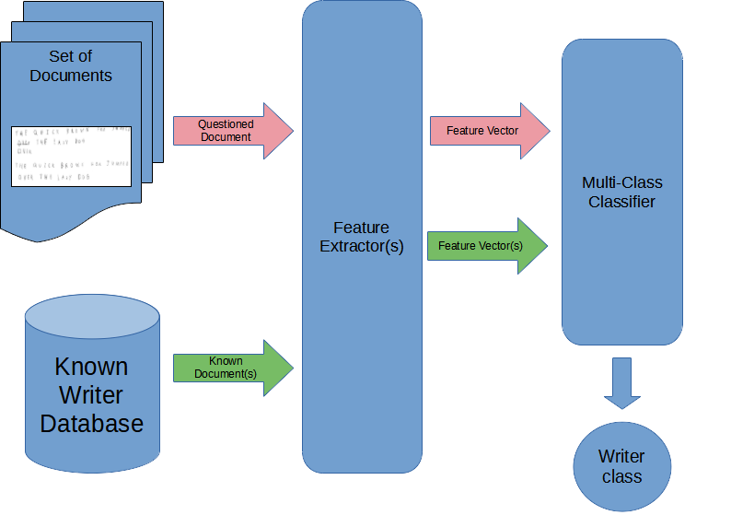
Writer Identification Model
Questioned Document(s) are processed by the models feature extractors to obtain comparable feature vectors
the features of the questioned document are compared with the features of a database of writers via a classification method

Slide 7
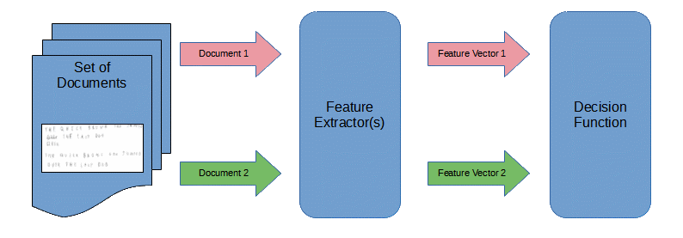
Writer Verification Model
Two documents (questioned or known) are pulled from the dataset
Their features are extracted by the model
The features of the two documents are compared and either a writer class or a similarity score are outputted

Slide 8
Multi-Script Writer Identification
Same as with regular Handwriting Identification, except:
The data can include documents written in multiple Writing-Scripts and/or Languages
Writers in the dataset can possibly produce documents in multiple Writing-Scripts and/or Languages
More complex problem due to visual differences of the Writing-Scripts

Slide 9
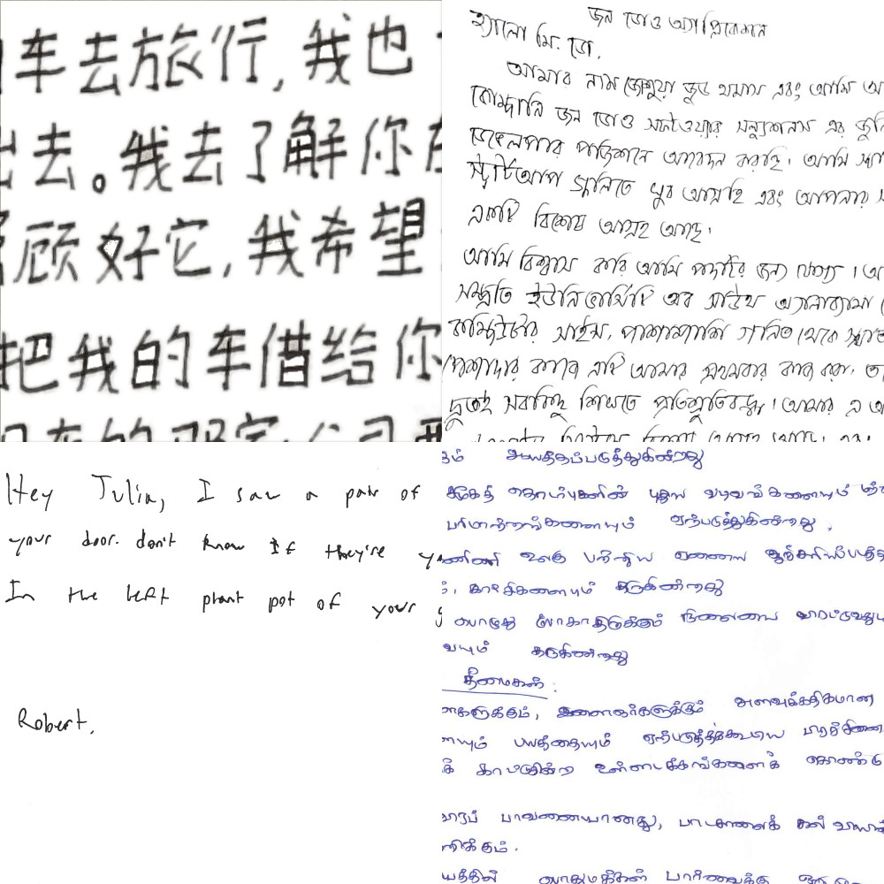
Multi-Script Writer Identification Continued
Chinese (top left), Bengali (top right), English (bottom left), Tamil (bottom right)
Problem detailed in the ICFHR 2018 Competition paper
Tries to find “… writing patterns that are common across different scripts [and] may be exploited to identify the writer” (Djeddi et al. ICFHR 2018 Competition on Multi-Script Writer Identification)
Competition Problem task is to train model on one writing script and then test on another.

Slide 10
Methodology and Testing

Slide 11
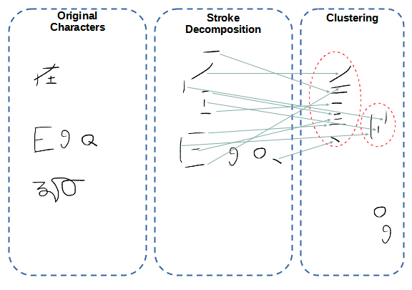
Stroke Decomposition
Idea is to insert a pre-processing step before analysis that split characters into approximate sub-strokes
prior research on the subject uses morphological processing
Complex characters are reduced into more comparable sub-strokes before feature extraction
Clustering algorithm used to pair similar strokes

Slide 12
Sub-Stroke Comparison Methods
Method 1: direct sub-stroke comparison
Match extracted sub-strokes from extracted documents and compare on a pair-by-pair basis
Method 2: extract n-most common sub-strokes
Train clustering model on a large and diverse dataset of multiple Writing-Scripts to find the n most-common sub-stroke classes
Save the n common cluster classes and extract sub-strokes matching those clusters

Slide 13
Testing Architecture
General Architecture of Proposed Testing Model for Handwriting Identification
Step 1: Binarization of Handwriting Documents
Step 2: Artefact Removal (noise, small pen textures, and ink-blobs)
Step 3: Stroke Decomposition and Clustering
Step 4: Feature Extraction of Processed Sub-Strokes, via Convolutional Neural Network (CNN)
Step 5: Classification via K-Nearest Neighbors
NOTE: May be changed or added to during the study

Slide 14
Dataset and Tasks
ICFHR 2018 Competition Tasks
Task 1: Train on Chinese then test on English
Task 2: Train on English then test on Chinese
Task 3: Train on Arabic and test on French
Task 4: Train on French and test on Arabic
Task 5: Train on Farsi and test on English
Task 6: Train on English and test on Farsi
ICFHR 2018 Competition uses three Multi-Script datasets
CERUG (Chinese and English)
LAMIS-MSHD (Arabic and French)
WDAD (Farsi and English)
Model tested and scored individually on each six different writing tasks
Each task trains on one part of the dataset and tests on the other

Slide 15
Testing Metrics
ICFHR competition models are evaluated using Soft Top-N identification rate
The rate at which the true writer of the documents appears within a list of the N most probable writers
Competition model evaluation uses Top-1 to Top-10 identification rates, evaluated separately
An overall ranking was calculated in the study by accumulating test rank in each of the four models

Slide 16
Conclusion and Implications
This study proposes Stroke-Decomposition, a preprocessing step inserted into a Handwriting Identification model (verification or identification) before feature extraction to extract Sub-Strokes common between documents of different writing scripts
Proposed for Multi-Script Handwriting Identification, which involves situations where questioned documents can be written in separate Writing-Scripts and where writers can write in multiple Writing-Scripts

